Slide 1
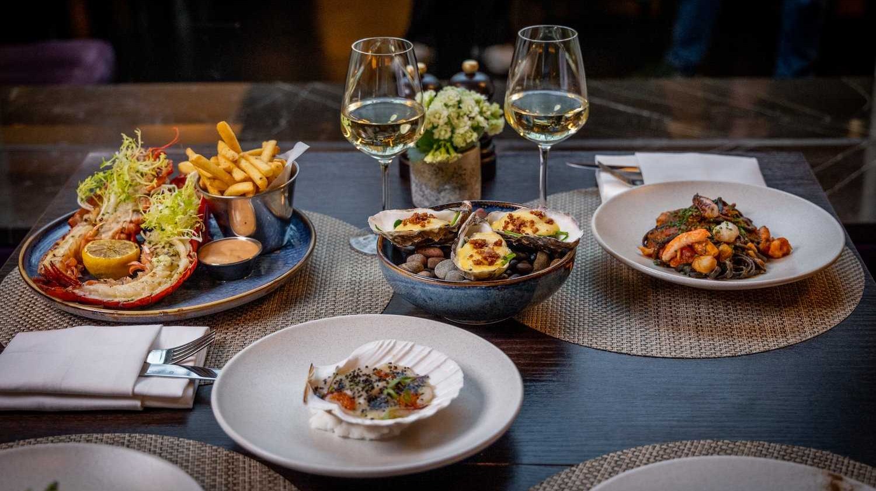

Catering Reservation and Ordering System
It's Our Expertise That brings Us Together. Your Dream Catering and Reservation.

Slide 2
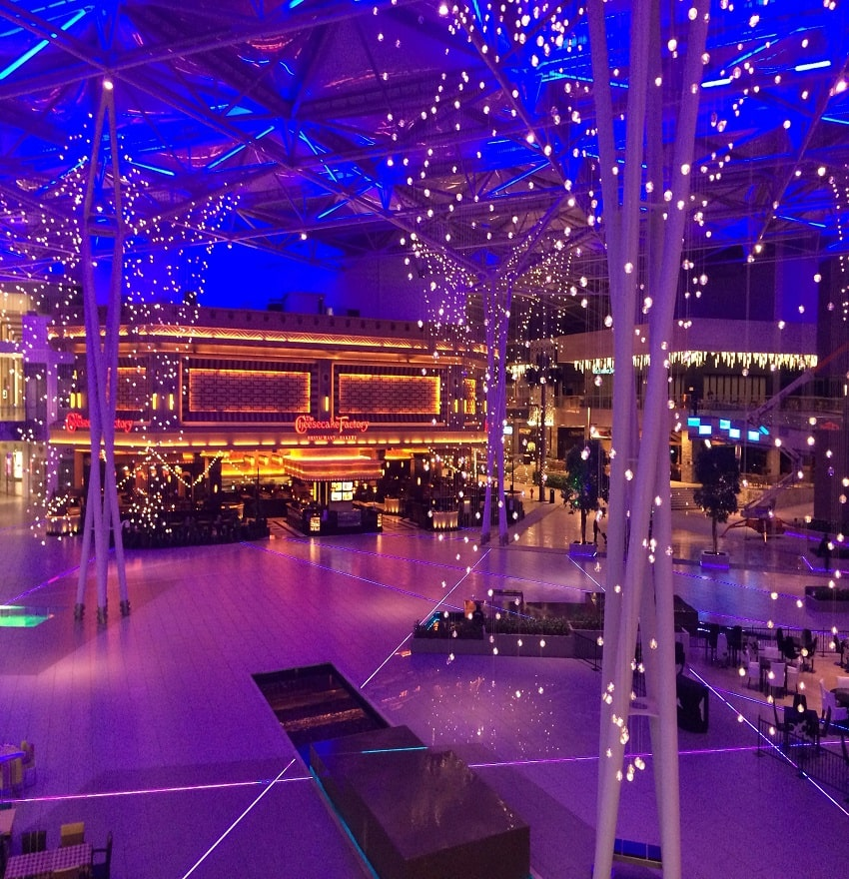

Introduction
Catering Services provide specialized food and beverages in large quantities for events and occasions. Catering services help in planning the menu, offering expert suggestions on dishes and even providing large serving dishes and cutlery for the event. Make your occasions a memorable one with experienced Caterers in serving authentic Food styles.

Slide 3
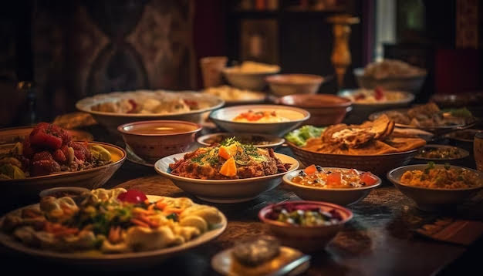

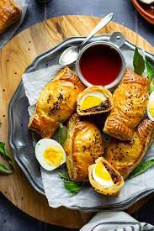
Problem statement
Catering is a website that allows counter developers to promote and sell their catering. Rural towns would be able to sell their commodities to the rest of the globe as a result of this.
The goal of this project is to establish a portal that will allow users to buy catering from the admin and change product information securely using a mobile device. Catering is given priority in order to allow them to develop their skills and promote our traditional Indian culture.

Slide 4
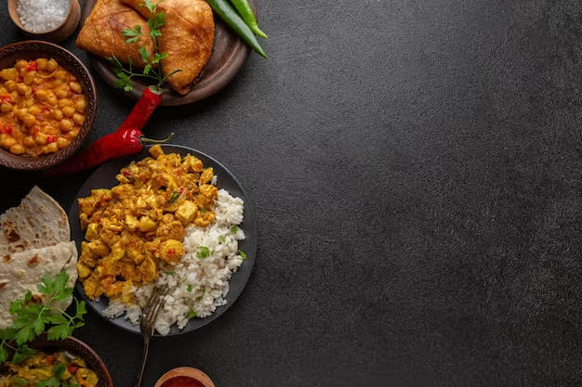
Objective
The objective of the catering reservation and ordering system project is to create a comprehensive and user-friendly platform that streamlines the process of booking catering services and placing orders for events.
The system aims to provide a seamless experience for both customers and catering businesses by offering features such as online reservation management, menu customization, Add to Cart options and integrating advanced functionalities, the project seeks to enhance efficiency, accuracy, and customer satisfaction in the catering industry.

Slide 5
Project Module
User Module
Register and Login
View Product
Add to cart
My order
Place order
My profile

Slide 6
Admin Module
Register and Login
Add Product Details
View Order

Slide 7
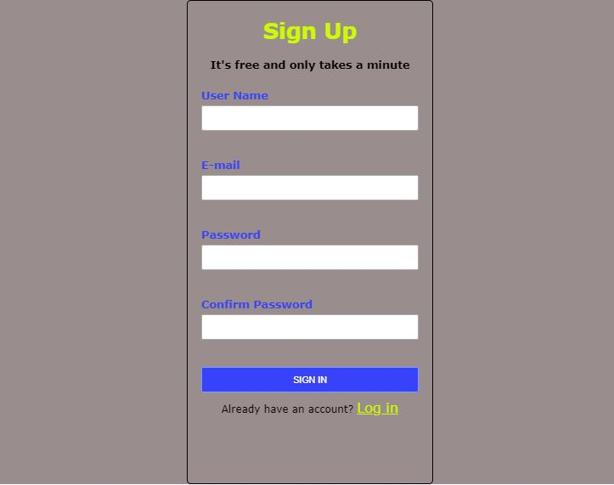
Sign UP Page

Slide 8
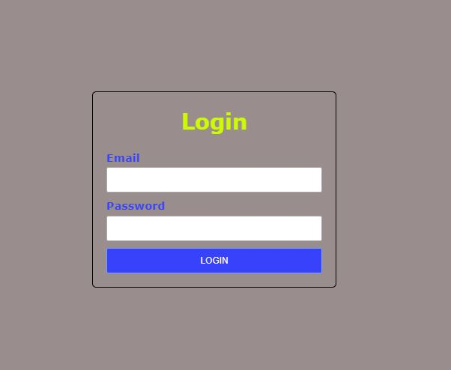
Login Page

Slide 9
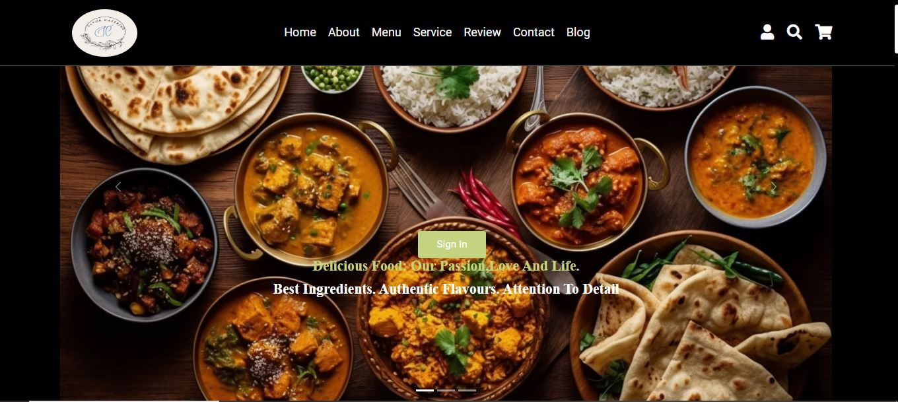

Slide 10
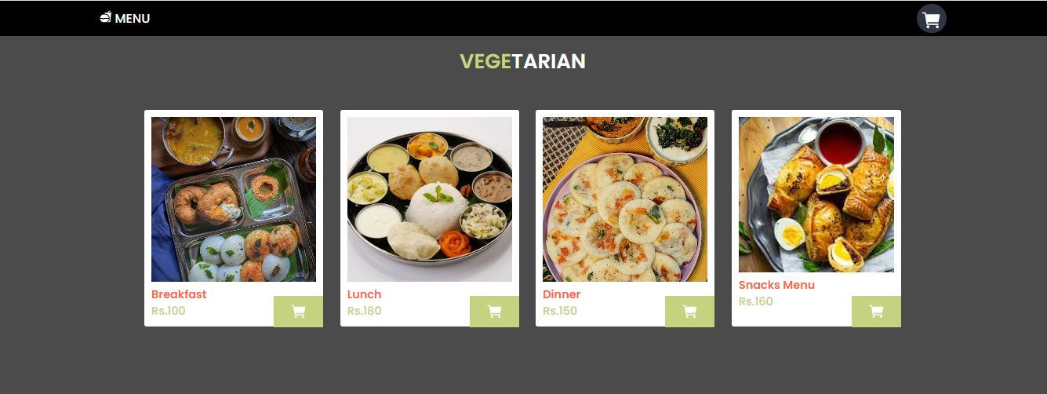
Menu

Slide 11
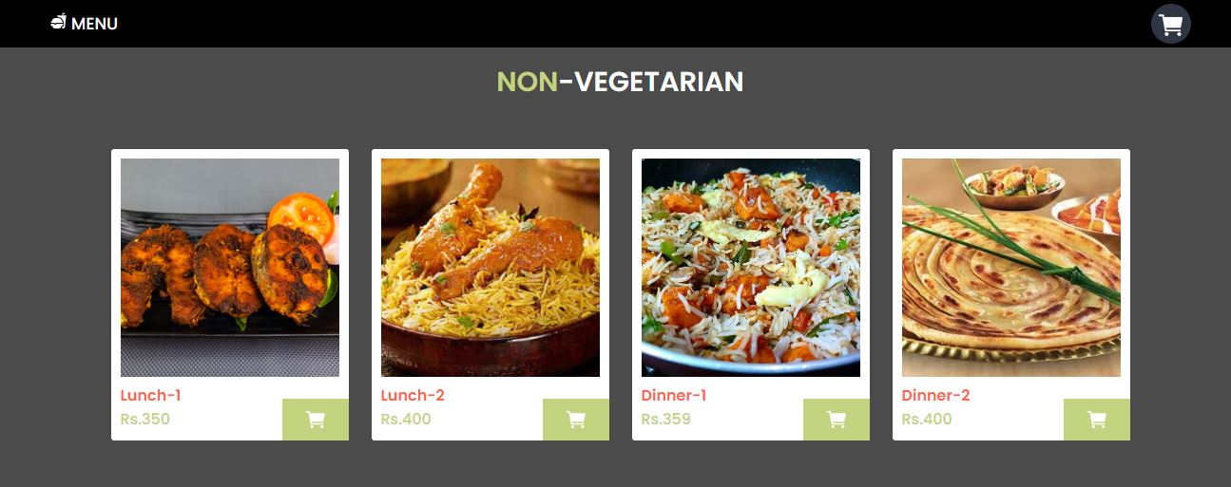
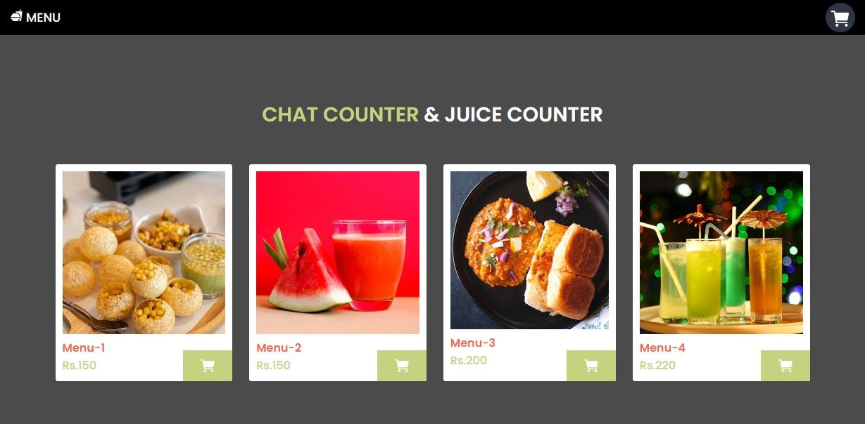

Slide 12
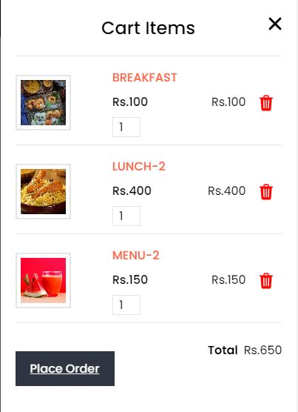
Add To Cart

Slide 13
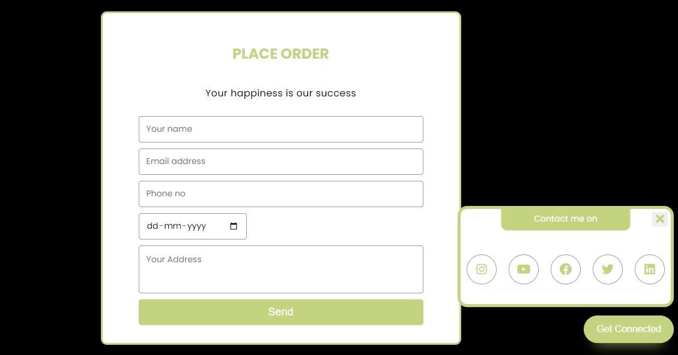
Place order

Slide 14
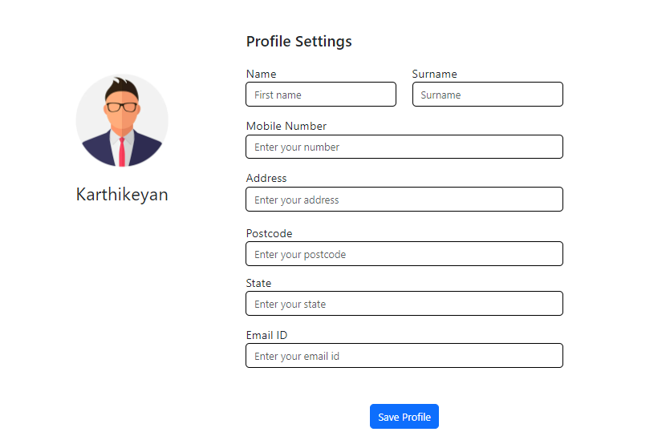
Profile Page

Slide 15
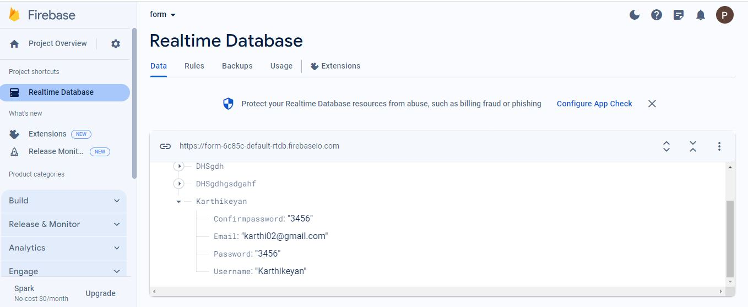
Database Firebase

Slide 16
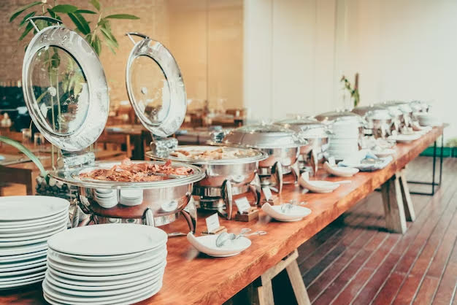
Conclusion
In conclusion, the development of the catering reservation and ordering system represents a significant
step forward in modernizing and optimizing the catering industry. Through the implementation of innovative
technology and user-centric design, we have successfully created a platform that addresses the complexities
and challenges of managing catering reservations and orders.
This system offers numerous benefits to both customers and catering businesses. Customers now have the
convenience of easily browsing menus, customizing their orders and securely booking catering services online.
On the other hand, catering businesses can efficiently manage reservations, track orders, and used
Firebase to store user profiles and login credentials in database.
As we move forward, we remain dedicated to continuously refining and expanding the capabilities of the
Catering reservation and ordering system to meet the evolving needs of our users. Through ongoing updates
and enhancements, we aim to further solidify our position as the go-to platform for catering services, offering
unparalleled convenience, reliability, and satisfaction to our valued customers and partners.

Slide 17
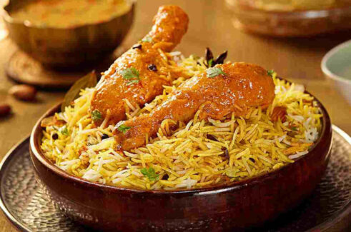
Thank You!

